Slide 1

Unit 8 The internet and internet services

Slide 2

History of Internet
In1957 During Cold War, Soviet Union projected first artificial satellite Sputnik in to the space.
In1960s, when the U.S. Department of Defense's Advanced Research Projects Agency (ARPA later called DARPA) began researching ways to create a decentralized communication system that would be resilient in the event of a nuclear attack.
In the late 1960s, ARPA's research resulted in the creation of the ARPANET, a network of 2 computers that were connected to each other using packet switching technology. Packet switching allowed data to be broken up into small packets and sent over a network, with each packet being routed individually based on the destination address.
In the 1970s, ARPANET grew rapidly, connecting hundreds of universities and research institutions across the United States. TCP/IP protocol was used for standardizing packeting. The development of email and file transfer protocols made the network even more useful for sharing information.
In the 1980s, the National Science Foundation (NSF) created NSFNET, a faster and more reliable network that was open to all academic and research institutions. This led to the creation of the first internet service providers (ISPs), which provided commercial internet access to businesses and consumers.

Slide 3

History of Internet
The 1990s saw introduction World Wide Web developed by Tim Berners Lee, which made it easy to access and share information on the internet using a graphical interface. The introduction of web browsers like Mosaic and Netscape made it easy for non-technical users to navigate the web and find information. HTML is used to develop webpages till now.
In the early 2000s, social networking sites like Friendster and MySpace emerged, making it easy for users to connect and share information with each other online. The rise of mobile devices like smartphones and tablets led to a shift towards mobile-first web design, with websites and apps being optimized for small screens.
Today, the internet has become an essential part of modern life, with billions of people using it every day for everything from communication and entertainment to shopping and education.

Slide 4
Internetworking Protocol
A protocol is the set of standard rules for data representation, signaling, authentication and error detection required to send information over a communications channel.
TCP/IP is the protocol used in the Internet.
How TCP/IP works?
TCP protocol breaks data in packet containing address, sequencing information and error control information. Error control information is used to check that the packet arrived at the destination is the same as that sent from the source.
IP handles the transmission of packets over the network. It handles the addressing of packets and ensures that a packet reaches its destination traveling through multiple networks with multiple standards
TCP sequencing information in the packet is used to reassemble the packets in order, at their destination

Slide 5
Transmission Control Protocol(tcp)
Key features of TCP:
End to End Packet Delivery
Data Packeting
Reliable and connection oriented protocol
Efficient Flow control, Full duplex operation and Multiplexing
Ensures reliability by sequencing bytes with a forwarding acknowledgement number that indicates to the destination the next byte the source expect to receive
It retransmits the bytes not acknowledged with in specified time period

Slide 6
Internet Protocol(IP)
Key features of IP:
Main purpose is IP is the delivery of datagrams(piece of data) from the source host(source computer) to the destination host(receiving computer) based on their IP addresses.
Path determination and Routing of data packets.
IP is connectionless and unreliable protocol that doesn’t ensures the successful transmission of data. That’s why it is paired with reliable protocol such as TCP layer.

Slide 7
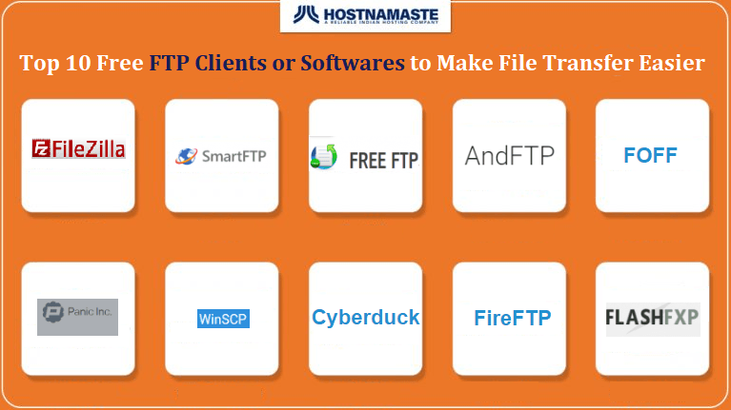
File transfer protocol(ftp)
Key features of FTP:
It is standard Internet protocol for transmitting files between computers on the Internet over TCP/IP connections.
Using FTP, a client can upload, download, delete, rename, move and copy files on a server.
User typically needs to log on to the FTP server.
Some server make some or all of their content available without login known as anonymous FTP.

Slide 8
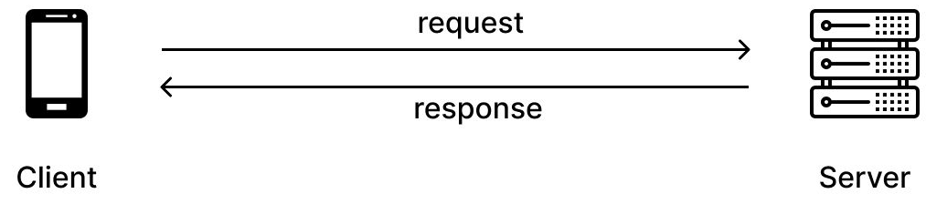
Hypertext transfer protocol(http)
Key features of HTTP:
It is set of rules for transferring files(text, graphic, images, sound, video, and other multimedia files) on the World Wide Web.
It is an application protocol that runs on top of the TCP/IP suite of protocols.
When you enter a URL in your, this actually sends an HTTP command to the web server directing it to fetch and transmit the requested web page.

Slide 9
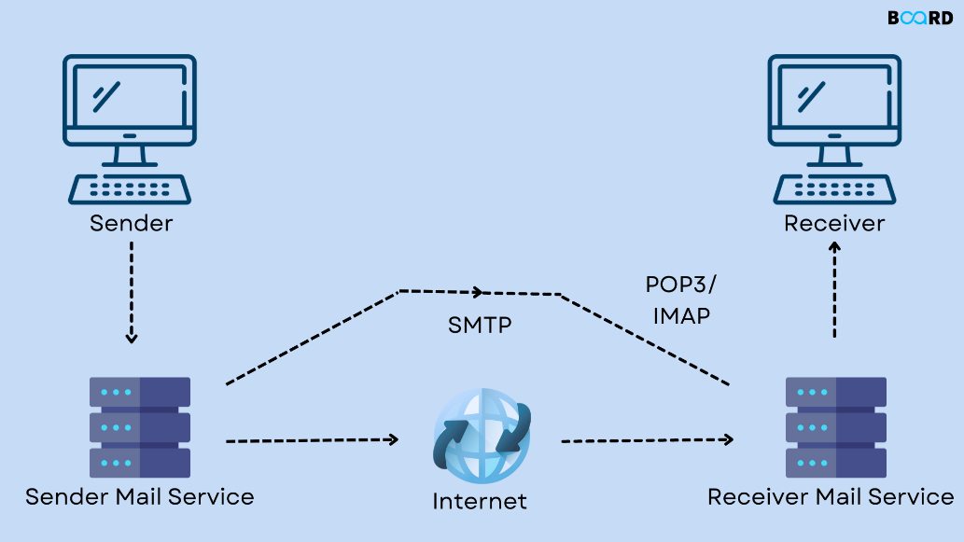
Simple Mail Transfer Protocol(SMTP)
Key features of SMTP:
It is application layer protocol/push protocol used to send the mail.
The client who wants to send the mail opens a TCP connection to the SMTP server.
SMTP server is always on listening mode.
Once connection is established client can send mail to mail server

Slide 10
Post office Protocol(POP)
POP application layer protocol used by email clients to retrieve email from mail server in IP network.
POP3 is version 3,most recent level of development in common use.
POP uses the TCP/IP protocol stack for network connection and works with SMTP for end to end email communication, where POP pulls messages and SMTP pushes to email server.
Alternative POP is IMAP( Internet Message Access Protocol) that provides more features that POP

Slide 11
Telnet
Features of TelNet:
It allows you to connect to remote computers over TCP/IP network.
Using Telnet client software on your computer, you can make a connection to a telnet server( i.e. remote host).
You’ll need to log into the remote host requiring the ID of host and permission of host.
Inbuilt application for remote login in windows is Remote login Desktop.
Several third party applications are available for all OS.
Anydesk, Teamviewer etc

Slide 12
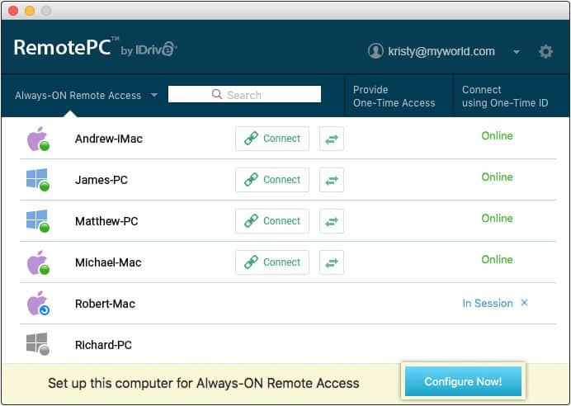
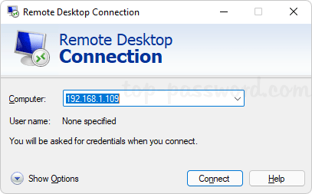
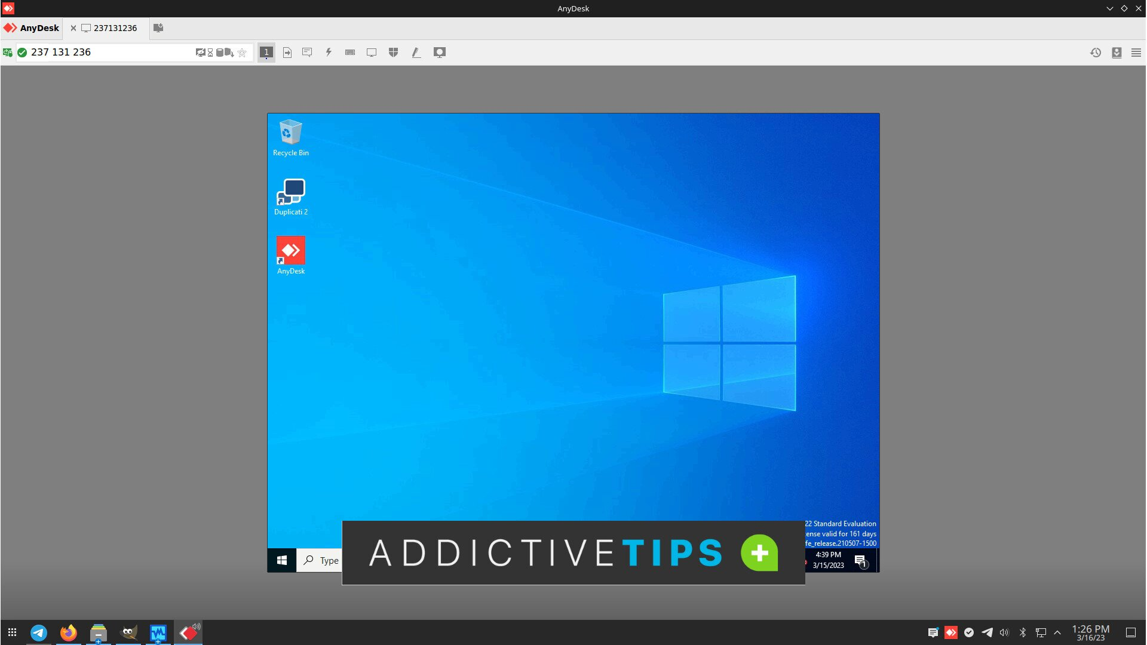
Telnet

Slide 13
Gopher
Features of Gopher are:
It is a communication protocol designed for distributing, searching, and retrieving documents in Internet Protocol networks.
The design of the Gopher protocol and user interface is menu driven and presented an alternative to the world wide web in its early stages but ultimately fell into HTTP.

Slide 14
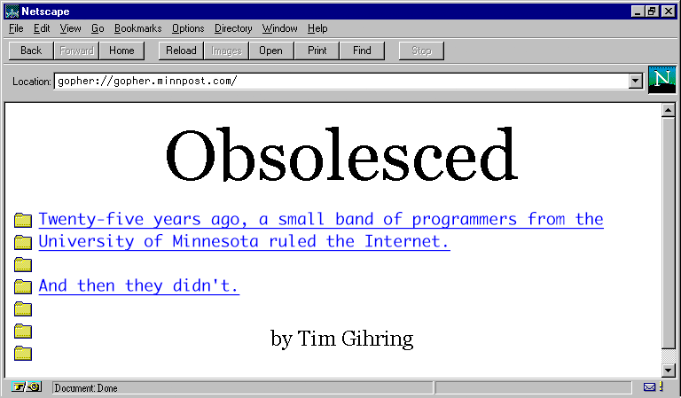
Gopher
Features of Gopher are:
It is a communication protocol designed for distributing, searching, and retrieving documents in Internet Protocol networks.
The design of the Gopher protocol and user interface is menu driven and presented an alternative to the world wide web in its early stages but ultimately fell into HTTP.

Slide 15
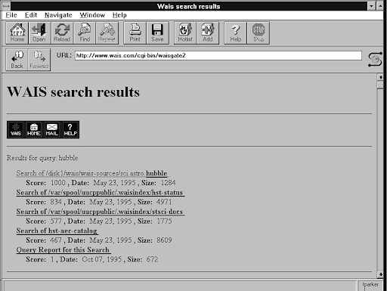
Wide area Information server(WAIS)
Wide area information service is a content-search service that finds the name of file given some information about the contents. It is very difficult for WAIS to search the contents of all files in the world. Therefore, the database has been divided into different sources. The user must limit the search to a particular source.
We can call it as outdated search engine.

Slide 16
Question???
Write the step by step process of SMTP and POP?

Slide 17
Internet Architecture
Backbone
Backbone are formed by large corporations like AT & T. Those corporations have their own server farms connected to the backbone.
Backbone is a giant pipeline capable of transporting data around the world in milliseconds.
There are many backbones in the world that are connected by network access point so that data can travel from one backbone to another backbone.
Internet Service Provider(ISP)
ISP is a company that provides customer with internet access
Data may be transmitted using several technologies including dialup, DSL, cable modem, wireless or dedicated highspeed interconnection.
Internet started as a closed network between government research laboratory and universities and colleges but now customer are allowed to be connected in internet through ISP
Customer get connection from Local ISP and Local ISP get connections from regional ISP and further multiple ISP reaching tier 1.

Slide 18
Internet Architecture
Clients
Clients lie at lowest level of internet hierarchy. Thes are the computers at home or offices that are connected to local ISP’s.

Slide 19

British telecom
Hyundai
Backbone
AT &T
Network Access Points
Network Access Points
Network Service Provider
Regional Service Provider
Internet Service Provider
Subscriber
Subscriber
Subscriber
Subscriber
Subscriber
Subscriber
Router

Slide 20

Internet Management
Who controls Internet?
It is often said that there is no central control, administration, or management of Internet. While this is generally true, there are several well known organization that work together. in a relatively well structured and roughly democratic environment to collectively participate in the research, development and management of the Internet
Those organizations are:
Internet Society(ISOC)
Internet Architecture Board(IAB)
Internet Engineering Task Force(IETF)

Slide 21
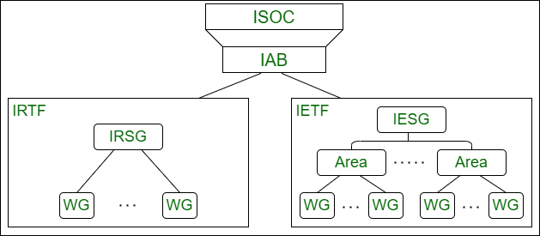
Internet Management

Slide 22

Internet Society
The ISOC oversees the other Internet management organizations described in the following points, and in some cases provides financial and other support.
It also holds an annual International Networking conference, and coordinates internet related public policy and trade activities, regional and local chapters, standardization activities, and an international secretariat.
One of the most important legal activities of the ISOC is defense of the free use of work “Internet” ensuring that it remains a generic term that is not trademarked or owned by any individual or corporation.

Slide 23

Internet architecture board
The roles and responsibilities of the IAB are:
Provide oversight of the internet architecture, protocols, procedures, and standards, RFC( Request for Comment) management, IESG (Internet Engineering Steering Group) selection, IETF oversight etc.
The internet activities board was renamed to internet architecture board by internet society in 1992.

Slide 24

Internet engineering task force
IETF studies operational and technical problems with the internet, specifies protocols and architectural solutions and makes recommendations to its steering committee.
Each are has one or two are directors. When an are director considers a problem important enough to merit concern, the IETF sets up a working group for further investigation.

Slide 25
Connecting to internet
Connecting to internet with a modem
Connecting to internet with broadband connection
Connecting to internet with smartphone

Slide 26
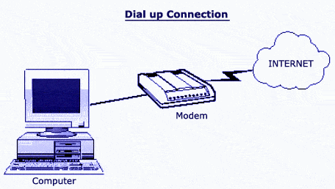
Connecting internet with modem
Your computer must have internal modem or external modem connected to computer.
It must be connected to your home phone line also called as landline.
It is old form of internet connection of these types of modems are now obsolete
It can only provide slow bandwidth 56k and telephone line becomes unusable during internet use.

Slide 27
Connecting internet with Broadband connection
Broadband is the transmission of wide bandwidth data over a highspeed internet connection.
According to FCC(federal communication commission, the definition of broadband internet is a minimum of 25 Mbps download and 3Mbps upload speed
Broadband connection can be done with fiber optics, wireless, coax cable , DSL and satellite.
In fiberoptics, media converter is used to convert light signal to digital signal and allows it to be connect to computer through ethernet.
In Coax cable and DSL, it requires splitter and modem.
In case or wireless, we can use broadband internet from 4G network to new.

Slide 28
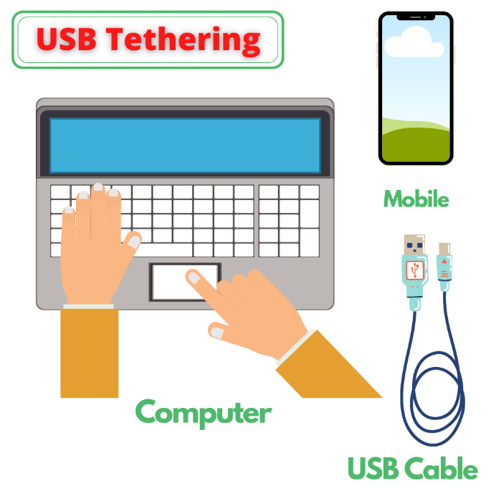
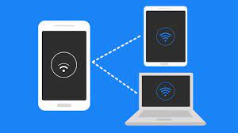
Connecting internet with smartphones
Todays, Smartphone is capable of hotspot and tethering the mobile cellular internet network to be distributed to computer laptop, other devices.
We cand either use USB cable for connection or WIFI network to establish hotspot

Slide 29
Internet connections
Dial up connection
ISDN
DSL
Cable TV internet connection
Wireless internet connection

Slide 30
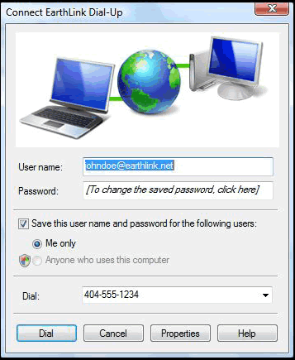
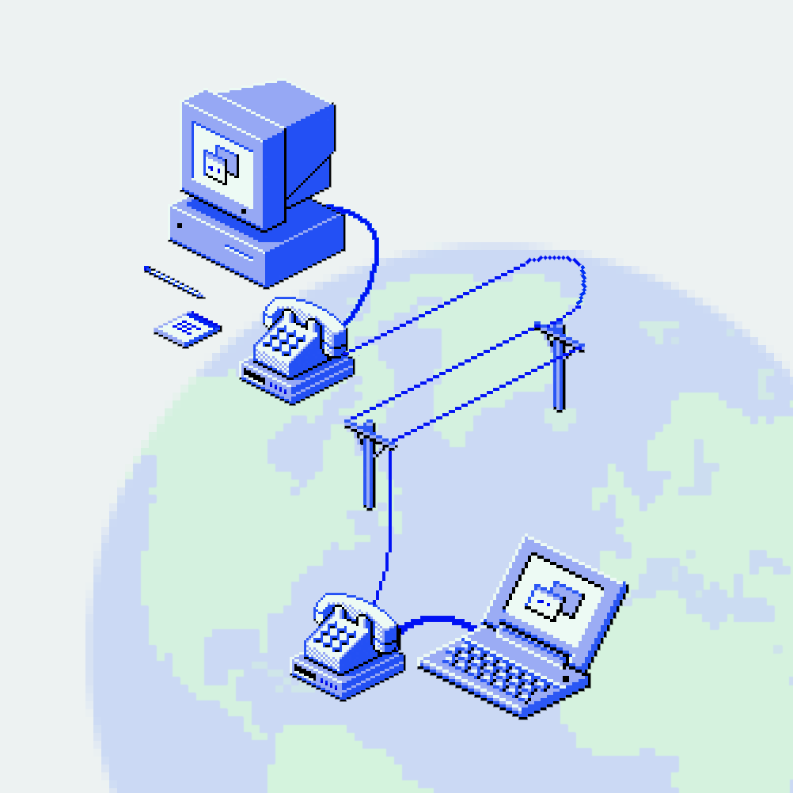
Dial up connection
Dial up connection uses telephone line to connect computer to the internet.
It requires modem to setup dial up connection.
It works as an interface between computer and the telephone line.
There is communication program that instructs the model to make a call to specific number provided by the ISP.
It supports up to 56 Kbps speed.

Slide 31
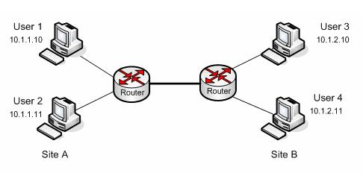
Leased lines
It is Internet Leased line is usually a dedicated line which offers direct connectivity to the internet.
This is done by connection the nearest service provider node point customer premises with a dedicated copper line, optical fiver cable, radio links or combination of the above.
It support high speed bandwidth since it has dedicated line for internet.

Slide 32
Integrated Service Digital Network(ISDN)
It establishes the connection using the phone lines which carry digital signal instead of analog signal.
It can carry both voice and internet signal through single line.
It doesn’t require modem rather than uses only ISDN adapter
Better bandwidth and reliable that dialup
ISDN lines are costlier and not widely available
Disadvantage of ISDN over DSL connection is ISDN still uses dialup mechanism and during connection telephone line are still disturbed.

Slide 33
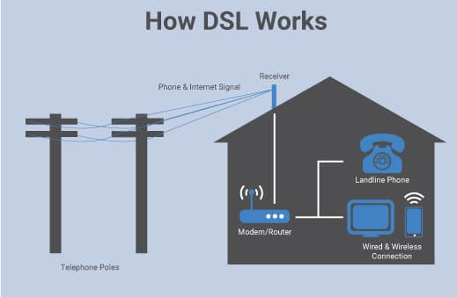
Digital Subscriber line(DSL)
It is a form of broadband connection as if provides connection over ordinary telephone lines. Some commonly used version of DSL technique are : Asymmetric DSL(ADSL), Symmetric DSL (SDSL). High bit rate DSL etc.
All of the mentioned technologies differ in their upload and download speed, bit transfer rate and level of service.
That’s because ISDN is a dial-up service that goes through a singular line. DSL connections never need to dial. They are sometimes called “always-on connections.” Because of that, DSL sends its packets at speeds up to 100 Mbps, while ISDN tops out around 128 Kbps.

Slide 34
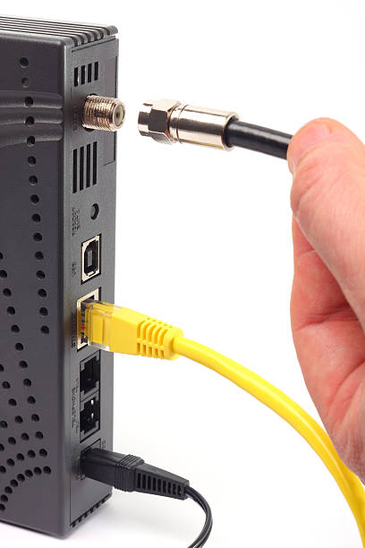
Cable Modem
Cable modem works similar as telephone but it uses coaxial cable used for cable TV.
The cable wire is connected in splitter and one cable is used for TV and another is plugged to cable modem.
Since the cable line are distributed among many subscribers, the bandwidth also gets distributed.

Slide 35
Application of Internet
Communication: The internet is widely used for communication, including email, instant messaging, voice and video calls, and social networking.
Information sharing: The internet enables individuals and organizations to share and access vast amounts of information, including news, research, and educational resources.
E-commerce: The internet has transformed the way we shop and do business, enabling e-commerce platforms like Amazon and eBay to connect buyers and sellers from around the world.
Entertainment: The internet provides a wide range of entertainment options, including streaming services for movies and TV shows, online gaming, and social media.
Education: The internet has revolutionized education, with many schools and universities offering online courses and resources that can be accessed from anywhere in the world.

Slide 36
Application of Internet
Healthcare: The internet is increasingly being used in healthcare, enabling remote consultations, telemedicine, and the sharing of medical information and resources.
Government services: The internet enables citizens to access government services and information, including tax forms, public records, and online voting.
Transportation: The internet is being used to revolutionize transportation, with the development of autonomous vehicles and smart traffic systems that use real-time data to optimize traffic flow.
Smart homes and cities: The internet is being used to create smart homes and cities, with connected devices and sensors that can monitor and control various aspects of daily life, from lighting and temperature to traffic and public services.
Overall, the internet has become an essential part of modern life, with countless applications that are transforming the way we live, work, and communicate

Slide 37
Internet Services
WWW
Email
File Transfer
Video conferencing

Slide 38
World wide web
It is a system of interlinked hypertext documents(called webpages) contained on the Internet.
A web page can contain text, graphics, animations, sound and video. All of the web pages maintained by an organization or individual are called a web site.
WWW uses Hypertext Transfer Protocol(HTTP) for fetching files (web pages) from internet.
HTTP is set of rules and standards that transmit requests and information between web browsers and web servers.
Web browser is a software application used to locate and display web pages.
Web server is a software application that delivers web pages. Some popular web servers are Apache, IIS( Internet Information Service)

Slide 39
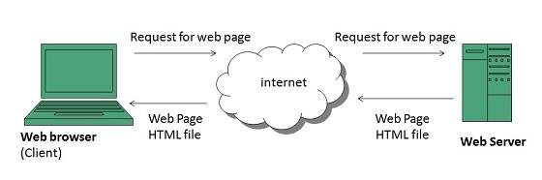
How www works?

Slide 40
How www works?
User enters the URL( Eg. http://www.ntc.org.np) of the web page in the address bar of web browser.
Then browser requests the Domain Name Server for the IP address corresponding to www.ntc.org.np.
After receiving IP address, browser sends the request for web page to the web server using HTTP protocol which specifies the way the browser and web server communicates
The web server receives request using HTTP protocol and cheecks its search for the requested web page. If found it returns it back to the web browser and close the HTTP connection.
Now the web browser receives the web pages, It interprets it and display the contents of web pages in web browser’s window.

Slide 41
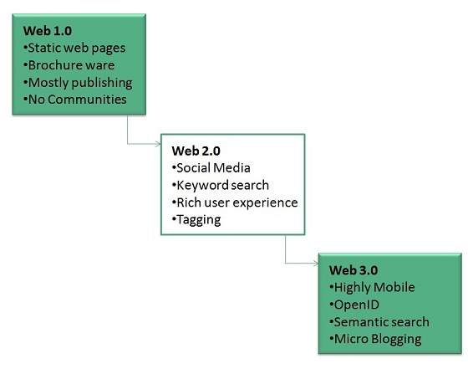
WWW Evolultion

Slide 42
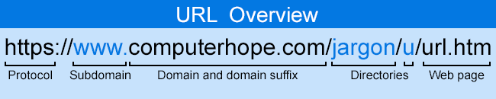
Uniform Resource Locater(URL)
URL is an addressing scheme used by web browsers to locate documents(web pages) and other resources on the World Wide Web.
For example: http://tuservicescommision.edu.np/notice.html
http is protocol
Second part is host name (tuservicescommision.edu.np)
Notice.html resource name.

Slide 43
E-mail
Electronic main is and electronic message transmitted over a network from one user to another. Email is text based main consisting of lines of text, and can include attachments such as audio messages, pictures and documents.
Email are comprised of three components:
Message envelope: Describes the email’s format
Message header: Includes sender/recipient email address and subject.
Cc: addresses where carbon copies of the same email will be sent. The recipients of email can see all email addresses to which the copies have been sent
Bcc: Addresses where blind carbon copies of the same email will be sent. The recipients of email do not know that the same email has been sent to other email addresses.
Size of email
Message body: Includes text, images and file attachments.

Slide 44
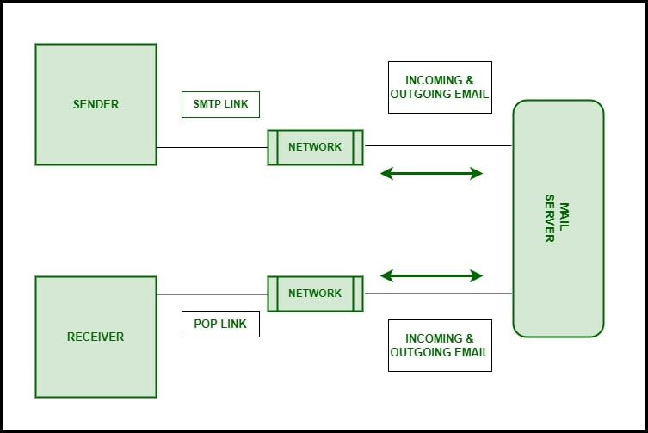
How E-mail works?

Slide 45
How E-mail works?
Email works on the client server model
Email clients are the users who wish to use the email facility. Both the sender of email and the recipient of email and email clients
Email server is a combination of processes running on a server with a large storage capacity. Alist of users and rules and the capability to receive, send, and store emails and attachments. These servers are designed to operate without constant user intervention.
The email client interacts with the email server to sent or receive email. Most email servers provide email services by running two separate processes on the same machin- Post Office Protocol 3(POP3) and Simple Mail Transfer Protocol(SMTP). Some email servers also run another process on the machine-IMAP
SMTP is used to send email from the client to server and from one server to another server.
POP3 is used by client for application based email to access mail from the server.
IMAP is used by client for web based email to access mail on server.

Slide 46
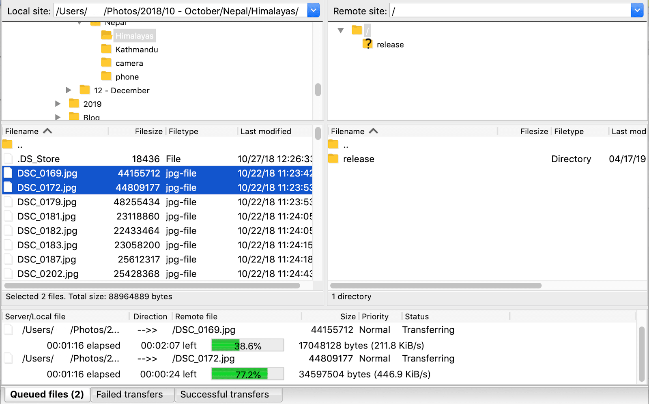
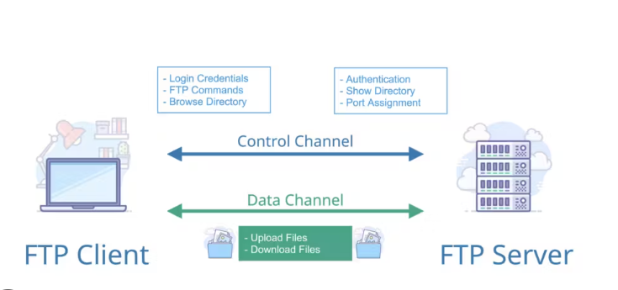
How FTp works?

Slide 47
Internet of Things(IOT)
IoT is the networking of physical objects that contain electronics embedded within their to communicate and sense interaction amongst each other or with respect to the external environment.
Advancements in medicine, gene therapies, agriculture, smart cities, and smart homes are just a very few of the categorical examples where IoT is strongly established.

Slide 48
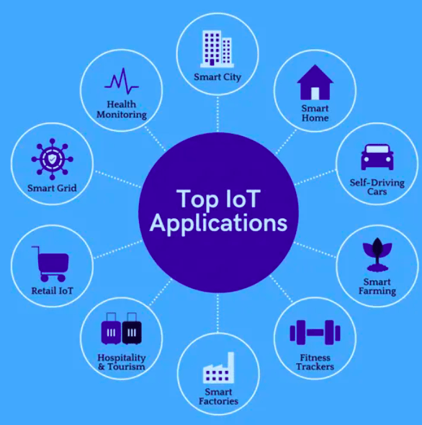
Internet of Things(IOT)

Slide 49
Internet of Things(IOT)
There are four main components used in IoT:
Low power embedded system: Less battery consumption, high performance are the inverse factors play a significant role during the design of electronic systems.
Cloud Computing: Data collected through IoT devices is massive and this data has to be stored on a reliable storage server for cloud computing. The data is processed and learned, giving more room for us to discover where things like electrical faults/errors are within the system,
Availability of big data: We know that IoT relies heavily on sensors, especially real time. As these electronic devices spread throughout every field, their usage is going to trigger a massive change of big data.
Networking connection: In order to communicate, internet connectivity is a must where each physical object is represented by an IP address.

Slide 50
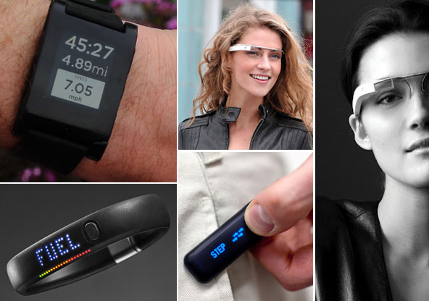

Wearable computing
Wearable computing is a term that refers to computer powered devices or equipment that can be worn by a user, including clothing, watches, glasses, shoes and similar items.
Wearable computing devices can range from providing very specific limited features like heart rate monitoring and pedometer capabilities to advanced smart functions and features similar to those a smartphone or smartwatch offers. Advance features like picture, video playback can also be found.
While wearable computing devices are only just now starting to emerge from the realm of science fiction into reality, rumored devices like Google Glasses and the Apple iWatch may soon bring advanced wearable computing devices into the mainstream.

Slide 51


Cloud computing
Cloud computing is defined as the use of hosted services, such as data storage servers, databases, networking and software over the internet.
In cloud services, the data center operates like the Internet and computing resources are accessed and shared as virtual resources in a secure and scalable manner.
In the cloud system, application and services are delivered and used over the Internet where a charge is paid by cloud customer typically on an “as needed, pay per use” business model. The benefit is that the cloud infrastructure is managed by the cloud provider, not the individual cloud customer.

Slide 52
E-Commerce
E-commerce refers to the buying and selling of goods and services over the internet. This includes any commercial transaction conducted online, including online shopping, online banking, and online auctions.
E-commerce websites typically provide a digital storefront where customers can browse and purchase products or services. They often use a variety of marketing techniques, such as email marketing, social media marketing, and search engine optimization (SEO) to attract customers to their websites.
E-commerce websites can range from small, simple sites that sell a few products to large, complex sites that offer a wide range of products and services. They often use various technologies to facilitate the buying process, including shopping carts, payment gateways, and secure sockets layer (SSL) encryption to protect sensitive information.

Slide 53
Types of E-Commerce
Business-to-Consumer (B2C) e-commerce: This is the most common type of e-commerce, where businesses sell products or services directly to individual consumers through an online storefront or marketplace. Examples include Amazon, Walmart, and eBay.
Business-to-Business (B2B) e-commerce: In this type of e-commerce, businesses sell products or services to other businesses through online marketplaces or custom-built e-commerce platforms. Examples include Alibaba, IBM, and Cisco.
Consumer-to-Consumer (C2C) e-commerce: This type of e-commerce involves individuals buying and selling products or services directly with each other through online marketplaces or social media platforms. Examples include eBay, Craigslist, and Facebook Marketplace.
Consumer-to-Business (C2B) e-commerce: In this type of e-commerce, individuals offer products or services to businesses. For example, freelance writers, designers, or photographers can offer their services to businesses through online marketplaces or their own websites.

Slide 54
E-Governance
E-governance, also known as electronic governance, refers to the use of information and communication technologies (ICTs) to improve the delivery of government services to citizens and businesses. E-governance aims to increase transparency, efficiency, and effectiveness in government operations and service delivery.
Some examples of e-governance include:
Online portals: Governments can create online portals where citizens can access information, apply for services, and pay fees and taxes. For example, citizens can access their tax records, apply for a passport or driving license, or renew their vehicle registration through an online portal.

Slide 55
E-Governance
Mobile applications: Governments can develop mobile applications that allow citizens to access government services from their smartphones. For example, citizens can receive alerts and updates on public services, report issues or complaints, or track their application status through mobile apps.
Electronic voting: Electronic voting allows citizens to cast their votes through electronic systems instead of paper ballots. Electronic voting can improve the accuracy and speed of vote counting and can also increase voter participation.

Slide 56
Smart city
Smart City is a designation given to city that incorporates information and communication technologies(ICT) to enhance the quality and performance of urban services such as energy, transportation and utilities in order to reduce resource consumption, wastage and overall costs.
To improve urban living and to optimize their resources, cities are folding internet connected devices into streetlights, municipal infrastructure, parking meters, and more, composing what could be called the “technological” portion of a smart city. Smart cities are using the Internet of Things(IoT) to improve the quality of life their citizens.

Slide 57
GIS
G stands for Geographic reference : Data of spatial coordinates on the surface of the earth(Map)-location data
IS stands for Information System: Database of attribute data corresponding to spatial location and procedures to provide information for decision making
Definition:
Geographic information system(GIS) is the system that captures, stores, analyzes , manages, and presents data with reference to geographic location data.
GIS is concerned with spatial or geographic data which refers to data that has a location upon the Earths’s surface.

Slide 58
Why use GIS?
Merges diverse data sources project specific information, socio economic, census, statistical and spatial base data such as administrative boundaries, roads, cities, infrastructure, etc
Manage all diverse data sources to prepare map, graph and reports and to report management for decision making process.
Visualizes and disseminates information.
Analyses data, illustrates trends, growth, and generates value added outputs.
Reveals important spatial relationships that facilitate understanding.
So GIS provides a platform for project planning, monitoring, reporting and data sharing for decision making process.

Slide 59
Basic GIS Function
Data input
Graphic data: digitized, converted from existing data
Attribute data: keyed-in, loaded from existing data files
Data storage and manipulation
File management, Editing, Geoprocessing(clip, merge, etc), reclassification
Data analysis
Database query, Spatial analysis, Modeling
Data output or display
Mapes, Reports, Tables, Graphs

Slide 60
Scope of GIS
Land registration system
Utilities such as Water supply, Electricity, Telephone, Irrigation networks
Topographical database
Forestry planning management
Transportation networks
Land use and land cover planning
Urban planning
Natural resource planning
Disaster management and mitigation
Environment impact studies

Slide 61
Geographical data
Spatial data
Point Object: School, hospital, settlement, bridge, tap stands etc.
Line objects: Roads, Drain, Canal, Electric line, W/S pipe line, etc
Polygon Objects: Forest, Lake, Cultivates area etc.
Non-spatial(Attribute data)-Like as Excel or Dbase
These are the properties of the spatial data. Each component has number of important properties which is presented in tabular form and also called attributes.

Slide 62
Client Server architecture
Client-server architecture is a type of computing architecture that divides computing tasks between two distinct types of software: client software and server software. This architecture is widely used in modern computing systems, including web applications, email servers, and file-sharing systems.
In a client-server architecture, the client software runs on the user's device and is responsible for user interaction and presentation. The client software communicates with the server software, which runs on a remote computer or server, to perform specific tasks or access resources.
The server software provides services to multiple client software instances simultaneously, enabling multiple users to access the same resources simultaneously. The server software is responsible for managing resources and performing tasks that require high processing power, storage, or specialized knowledge.

Slide 63

Client Server Architecture

Slide 64
Question:
Explain history of Internet. What is TCP/IP Model? How many layers are there? Explain each layer.

Slide 65
IP Address
An IP address, or Internet Protocol address, is a unique identifier assigned to every device connected to the internet. It is a numerical label assigned to each device that is connected to a computer network using the Internet Protocol for communication.
There are two versions of IP addresses: IPv4 and IPv6. IPv4 is the most widely used version and consists of four sets of numbers separated by dots (e.g., 192.168.0.1). IPv6, on the other hand, consists of eight sets of alphanumeric characters separated by colons (e.g., 2001:0db8:85a3:0000:0000:8a2e:0370:7334).
IP addresses are used to identify and locate devices on the internet, and they are crucial for sending and receiving data over the internet. When you connect to a website or a service on the internet, your device's IP address is sent to the server to establish a connection and exchange data.

Slide 66
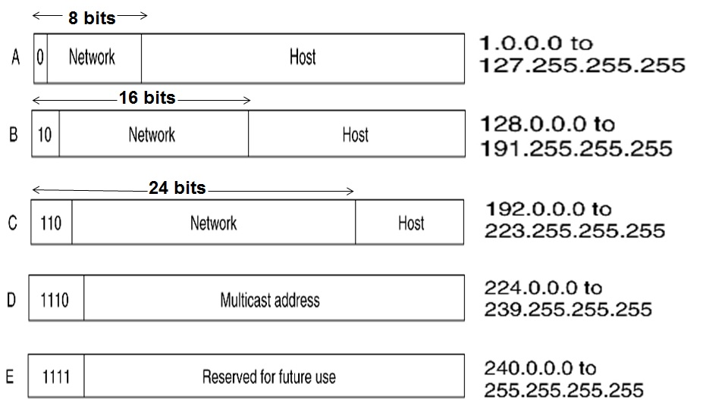
Class of IP Address
IP addresses are divided into five classes: A, B, C, D, and E. Classes A, B, and C are used for IP addresses assigned to hosts on the internet, while classes D and E are used for special purposes.

Slide 67
Class of IP address
Class A addresses use the first octet to identify the network and the remaining three octets to identify the hosts. The range of Class A addresses is from 1.0.0.0 to 126.255.255.255.
Class B addresses use the first two octets to identify the network and the remaining two octets to identify the hosts. The range of Class B addresses is from 128.0.0.0 to 191.255.255.255.
Class C addresses use the first three octets to identify the network and the remaining octet to identify the hosts. The range of Class C addresses is from 192.0.0.0 to 223.255.255.255.

Slide 68
Class of IP Address
Class D addresses are used for multicast IP addresses, which are used to send a single message to multiple hosts. The range of Class D addresses is from 224.0.0.0 to 239.255.255.255.
Class E addresses are reserved for experimental or research purposes and are not used for normal internet communication. The range of Class E addresses is from 240.0.0.0 to 255.255.255.255.

Slide 69
Domain Name System(DNS)
The Domain Name System (DNS) is a decentralized system that translates domain names (like www.example.com) into IP addresses (like 192.0.2.1) that are used to locate resources on the internet.
DNS provides a hierarchical naming system for computers, services, or any resource participating in the internet, organized in a tree-like structure.
DNS plays a critical role in the functioning of the internet, allowing users to access websites and other resources using easy-to-remember domain names, rather than complex IP addresses.

Slide 70
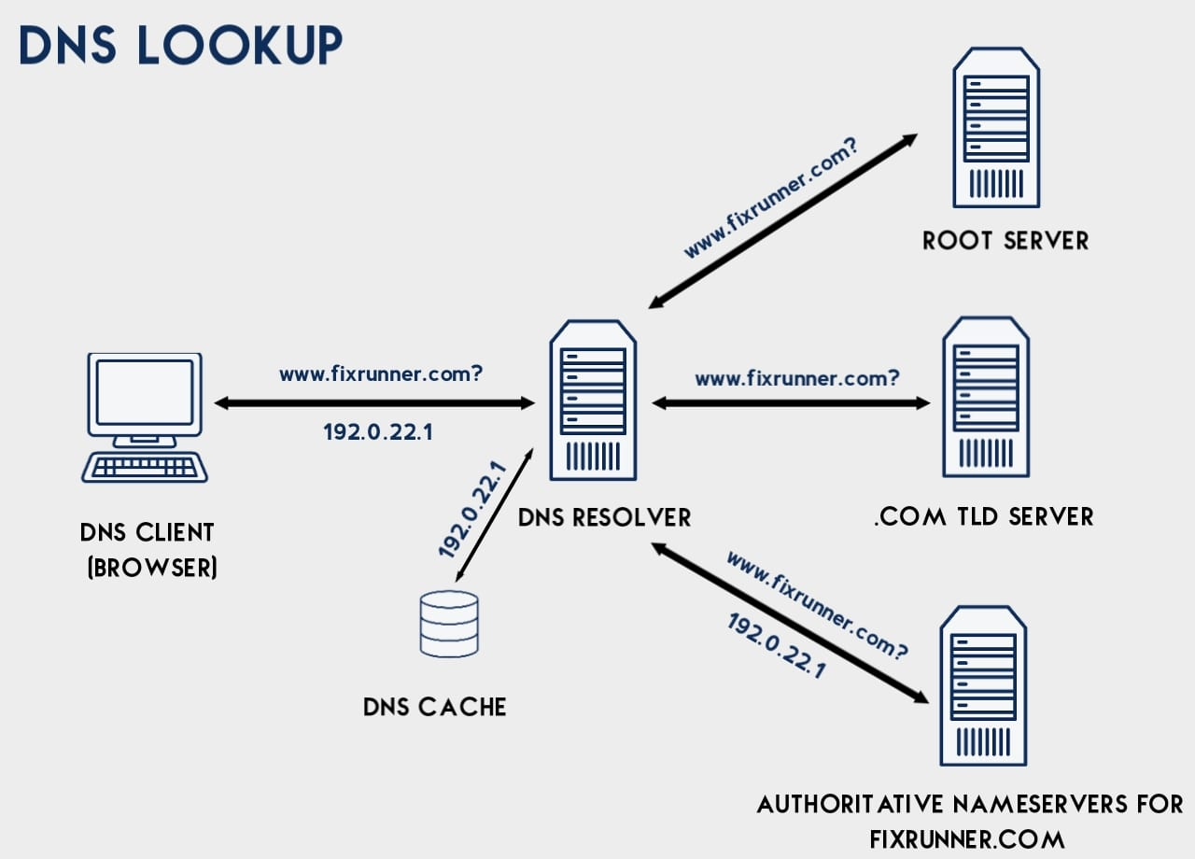
Architecture of DNS

Slide 71
Description:
DNS works by using a distributed database system, which is made up of millions of DNS servers around the world. When a user types a domain name into their web browser, the browser sends a request to the local DNS resolver, which is typically provided by the Internet Service Provider (ISP). If the local resolver does not have the IP address for the requested domain name in its cache, it sends a request to one of the root DNS servers to start the resolution process.
The root DNS server responds to the request with a referral to the appropriate Top-Level Domain (TLD) DNS server, such as .com, .org, .edu, or .gov. The TLD DNS server responds with a referral to the DNS server for the specific domain name, which then provides the IP address for the domain name to the local resolver. The local resolver caches the IP address for a certain amount of time to speed up future requests.

Slide 72
Question:
What is IP Address? What are the classes of IP address. Explain.
What is DNS? Explain with proper architecture.

Slide 73
Intranet and Extranet
An intranet is a private network within an organization that is used for internal communication and collaboration. It is accessible only to authorized members of the organization and is often used to share information, documents, and applications within the company. Intranets are typically hosted on a local server and are protected by firewalls and other security measures.
An extranet, on the other hand, is a network that allows external users such as customers, vendors, and partners to access a limited portion of an organization's intranet. It provides a secure and controlled platform for these external parties to communicate and collaborate with the organization's internal team. Access to the extranet is typically granted through authentication procedures, and users are only allowed to access the specific information or applications that are relevant to their role or relationship with the organization.

Slide 74
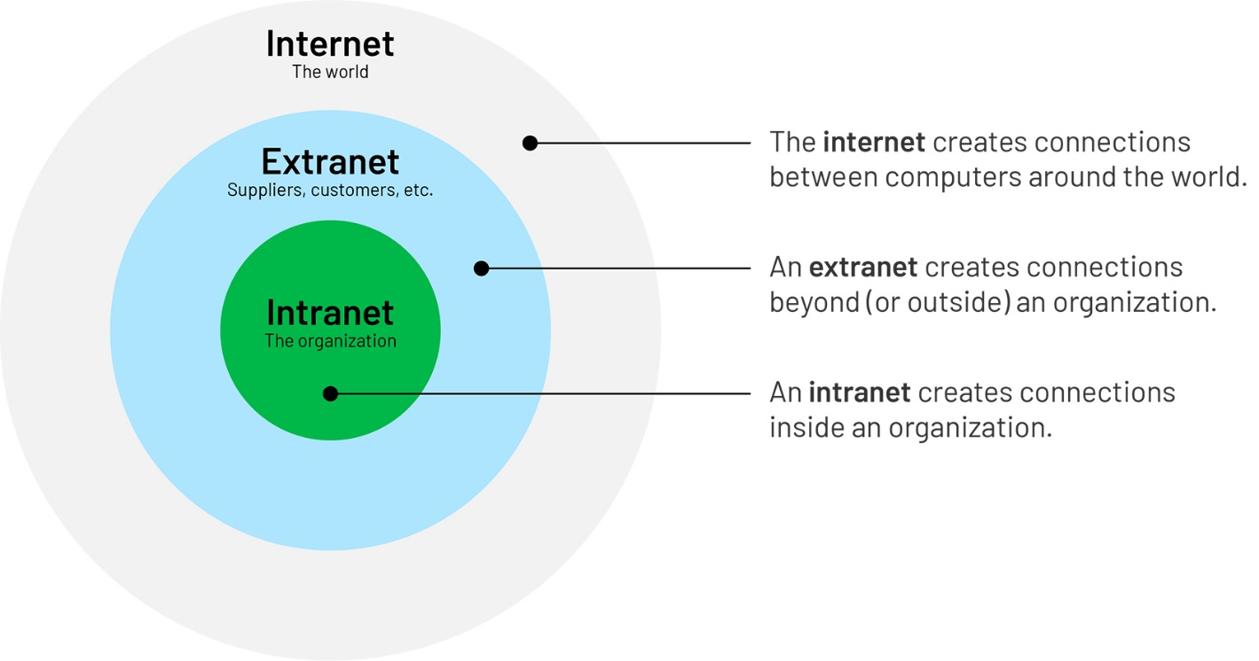
Intranet and Extranet

Slide 75
Static and Dynamic Webpage
A static webpage is a webpage that has a fixed content, meaning that the content of the webpage remains the same until it is manually updated.
The HTML code for a static webpage is created and saved on a server, and when a user accesses the webpage, they are presented with the same content every time.
Examples of static webpages include simple websites that provide information about a company, its products or services, and contact information.
A dynamic webpage, on the other hand, is a webpage that changes based on user input or other variables. The content of a dynamic webpage is generated on the server-side in real-time and is often customized for each user.

Slide 76
Static and Dynamic webpage
Dynamic webpages can use a variety of programming languages, such as PHP, Python, or Ruby, to access databases, run scripts, or retrieve information from APIs.
Examples of dynamic webpages include social media sites, e-commerce sites, online banking sites, and search engines.
Dynamic webpages often have interactive features, such as forms, buttons, and menus, that allow users to input data or make selections that trigger changes in the webpage's content.
Additionally, dynamic webpages can be updated more easily than static webpages since the content is generated automatically based on certain criteria, such as user preferences, device type, or location.

Slide 77
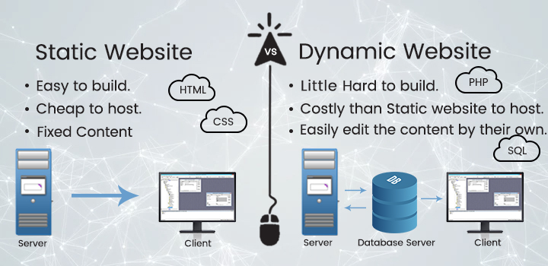
Static and dynamic webpage

Slide 78
Question:
Differentiate between Intranet and Extranet.
Differentiate between Static webpage and Dynamic Webpage.
How Internet plays important role in E-commerce and E-Governance. Explain with examples.

